Slide 1
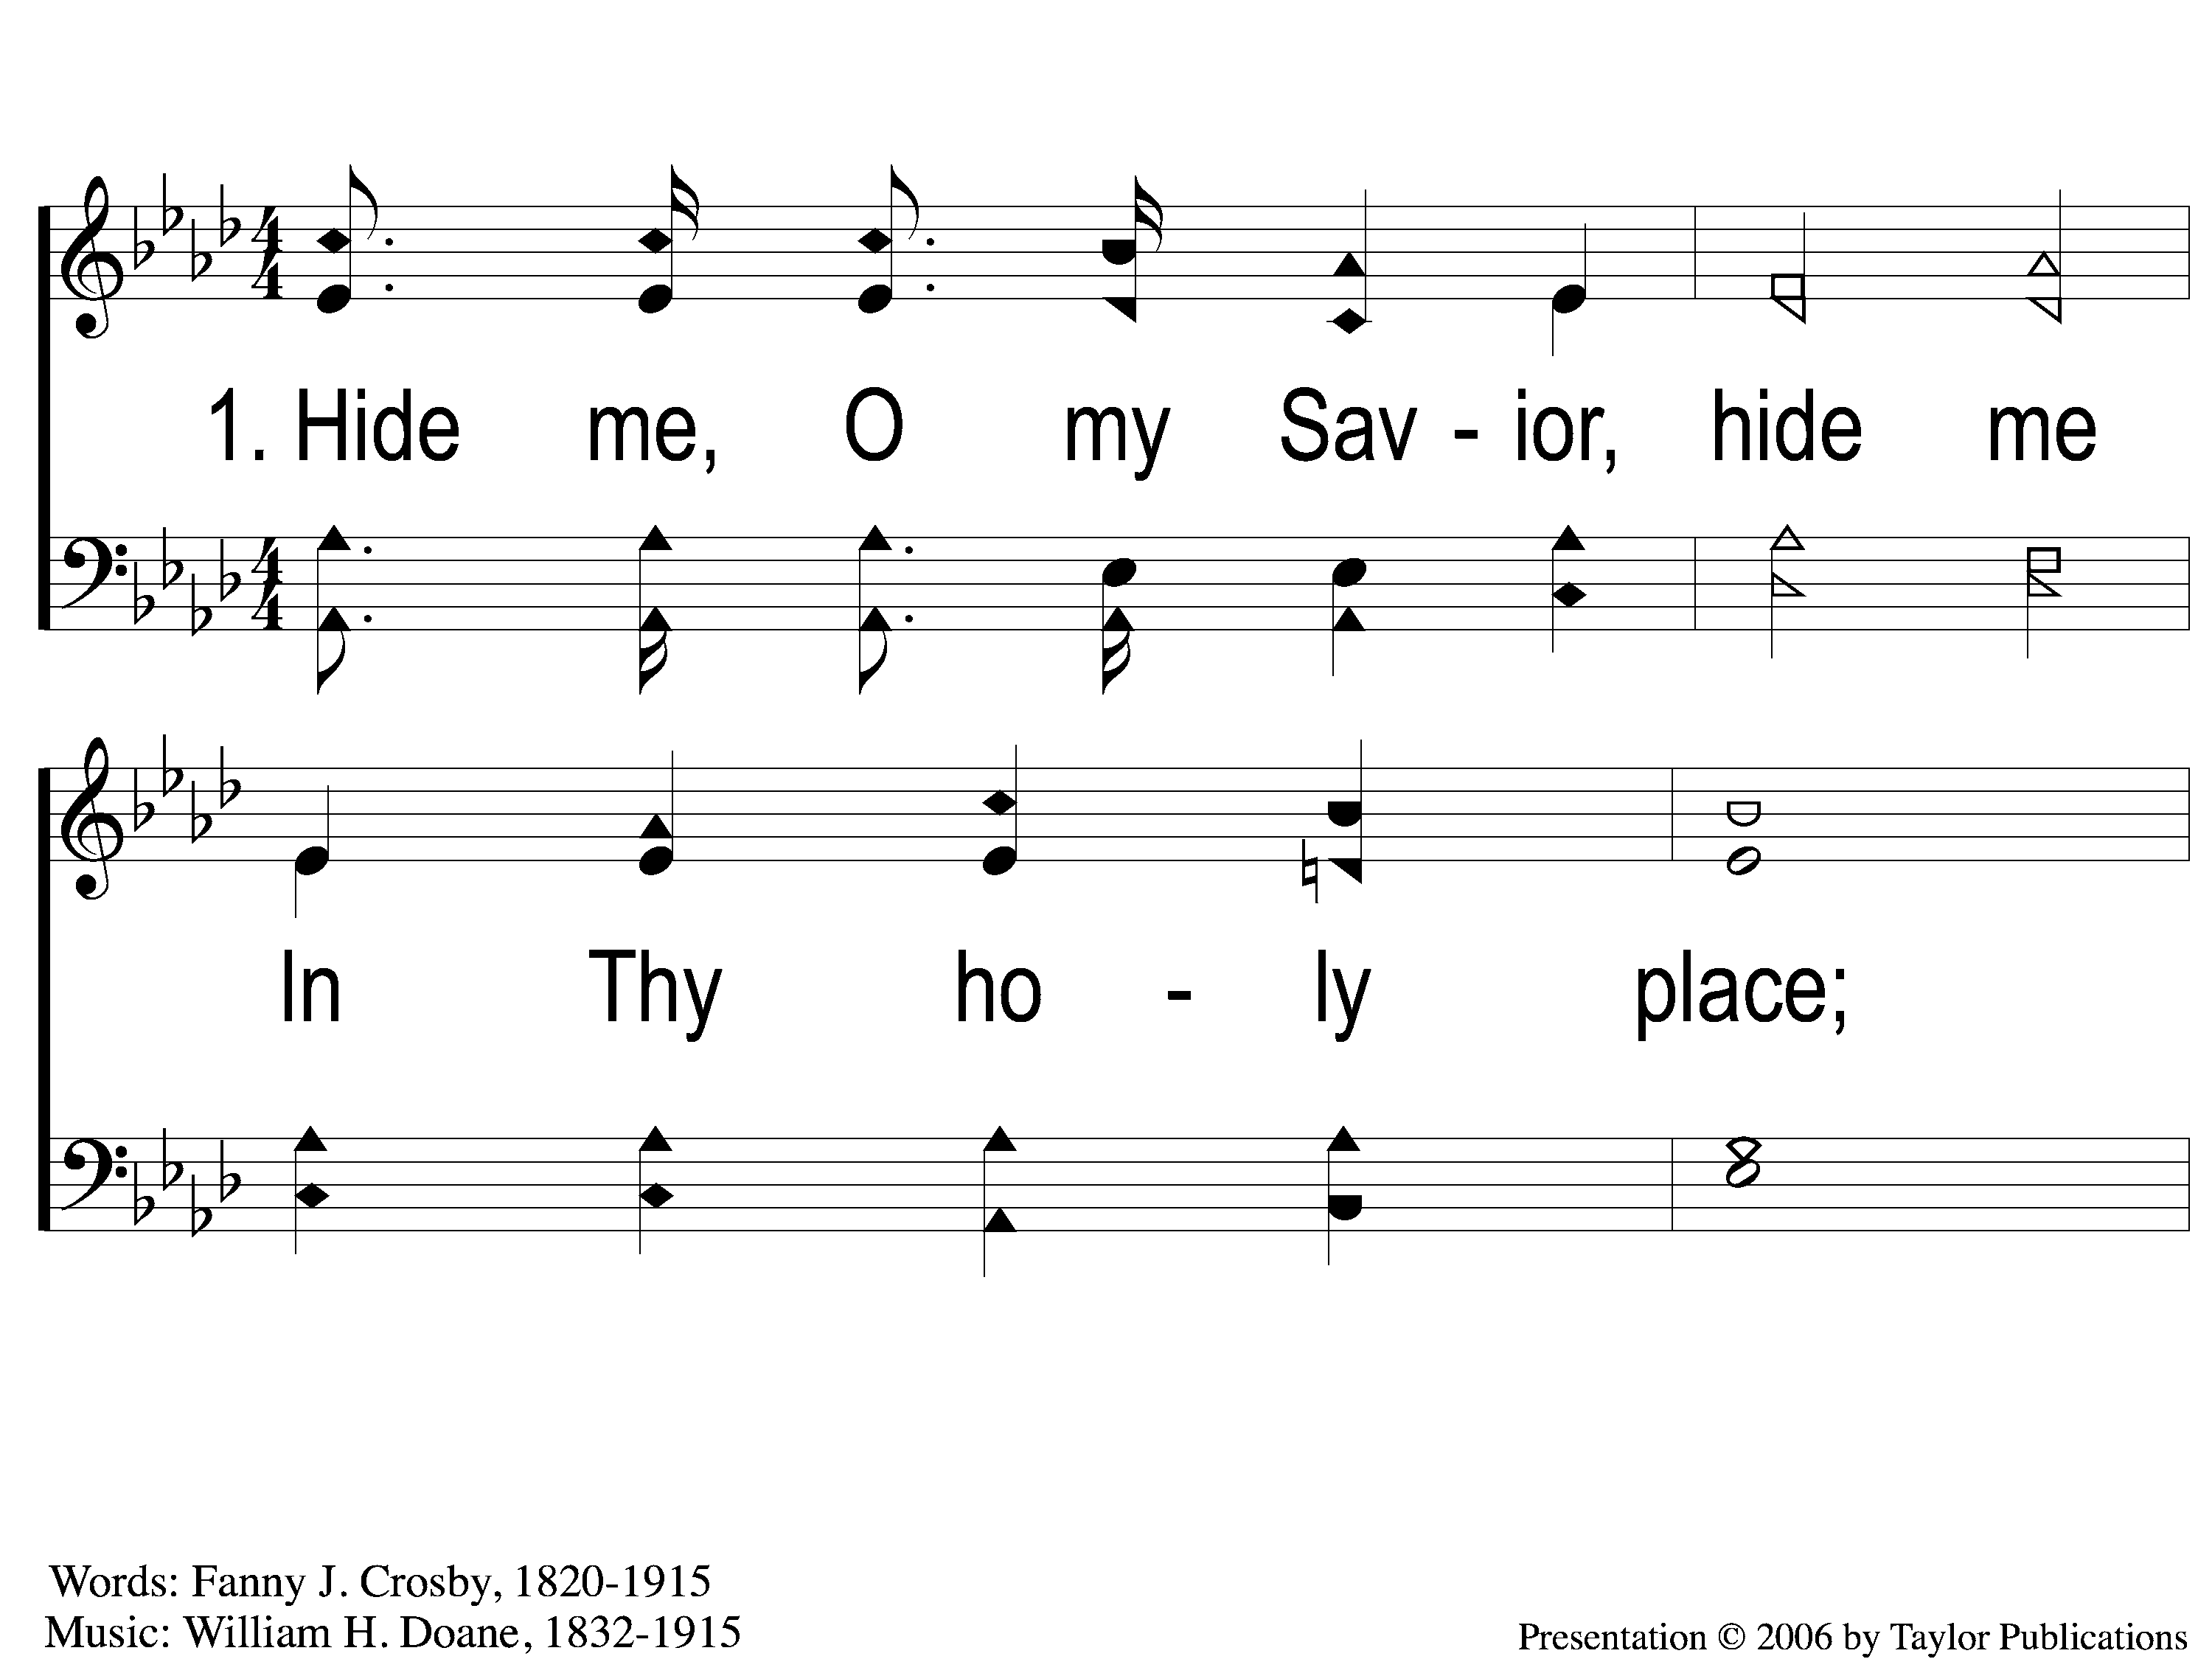
1-1 Hide Me, O My Savior
Hide Me, O My Savior
177

Slide 2
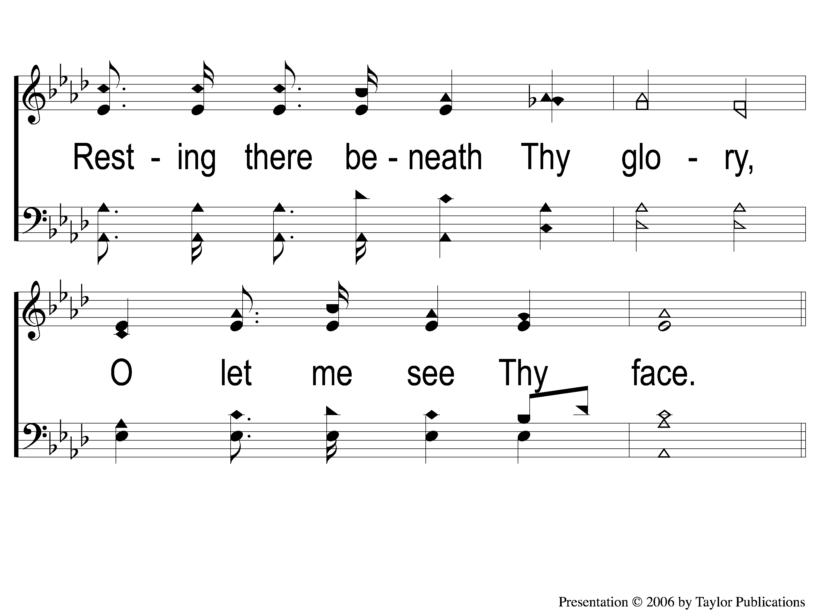
1-2 Hide Me, O My Savior
Hide Me, O My Savior
177

Slide 3
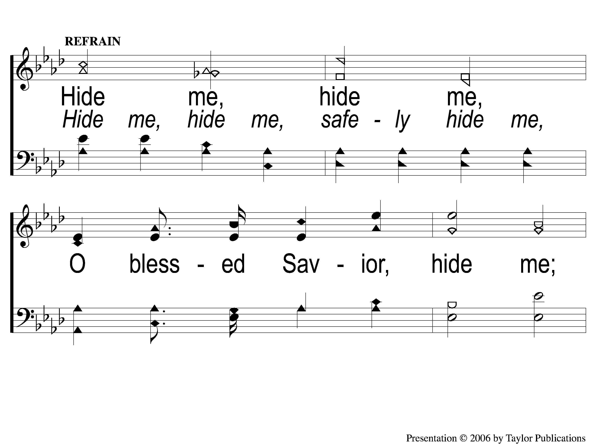
C-1 Hide Me, O My Savior
Hide Me, O My Savior
177

Slide 4
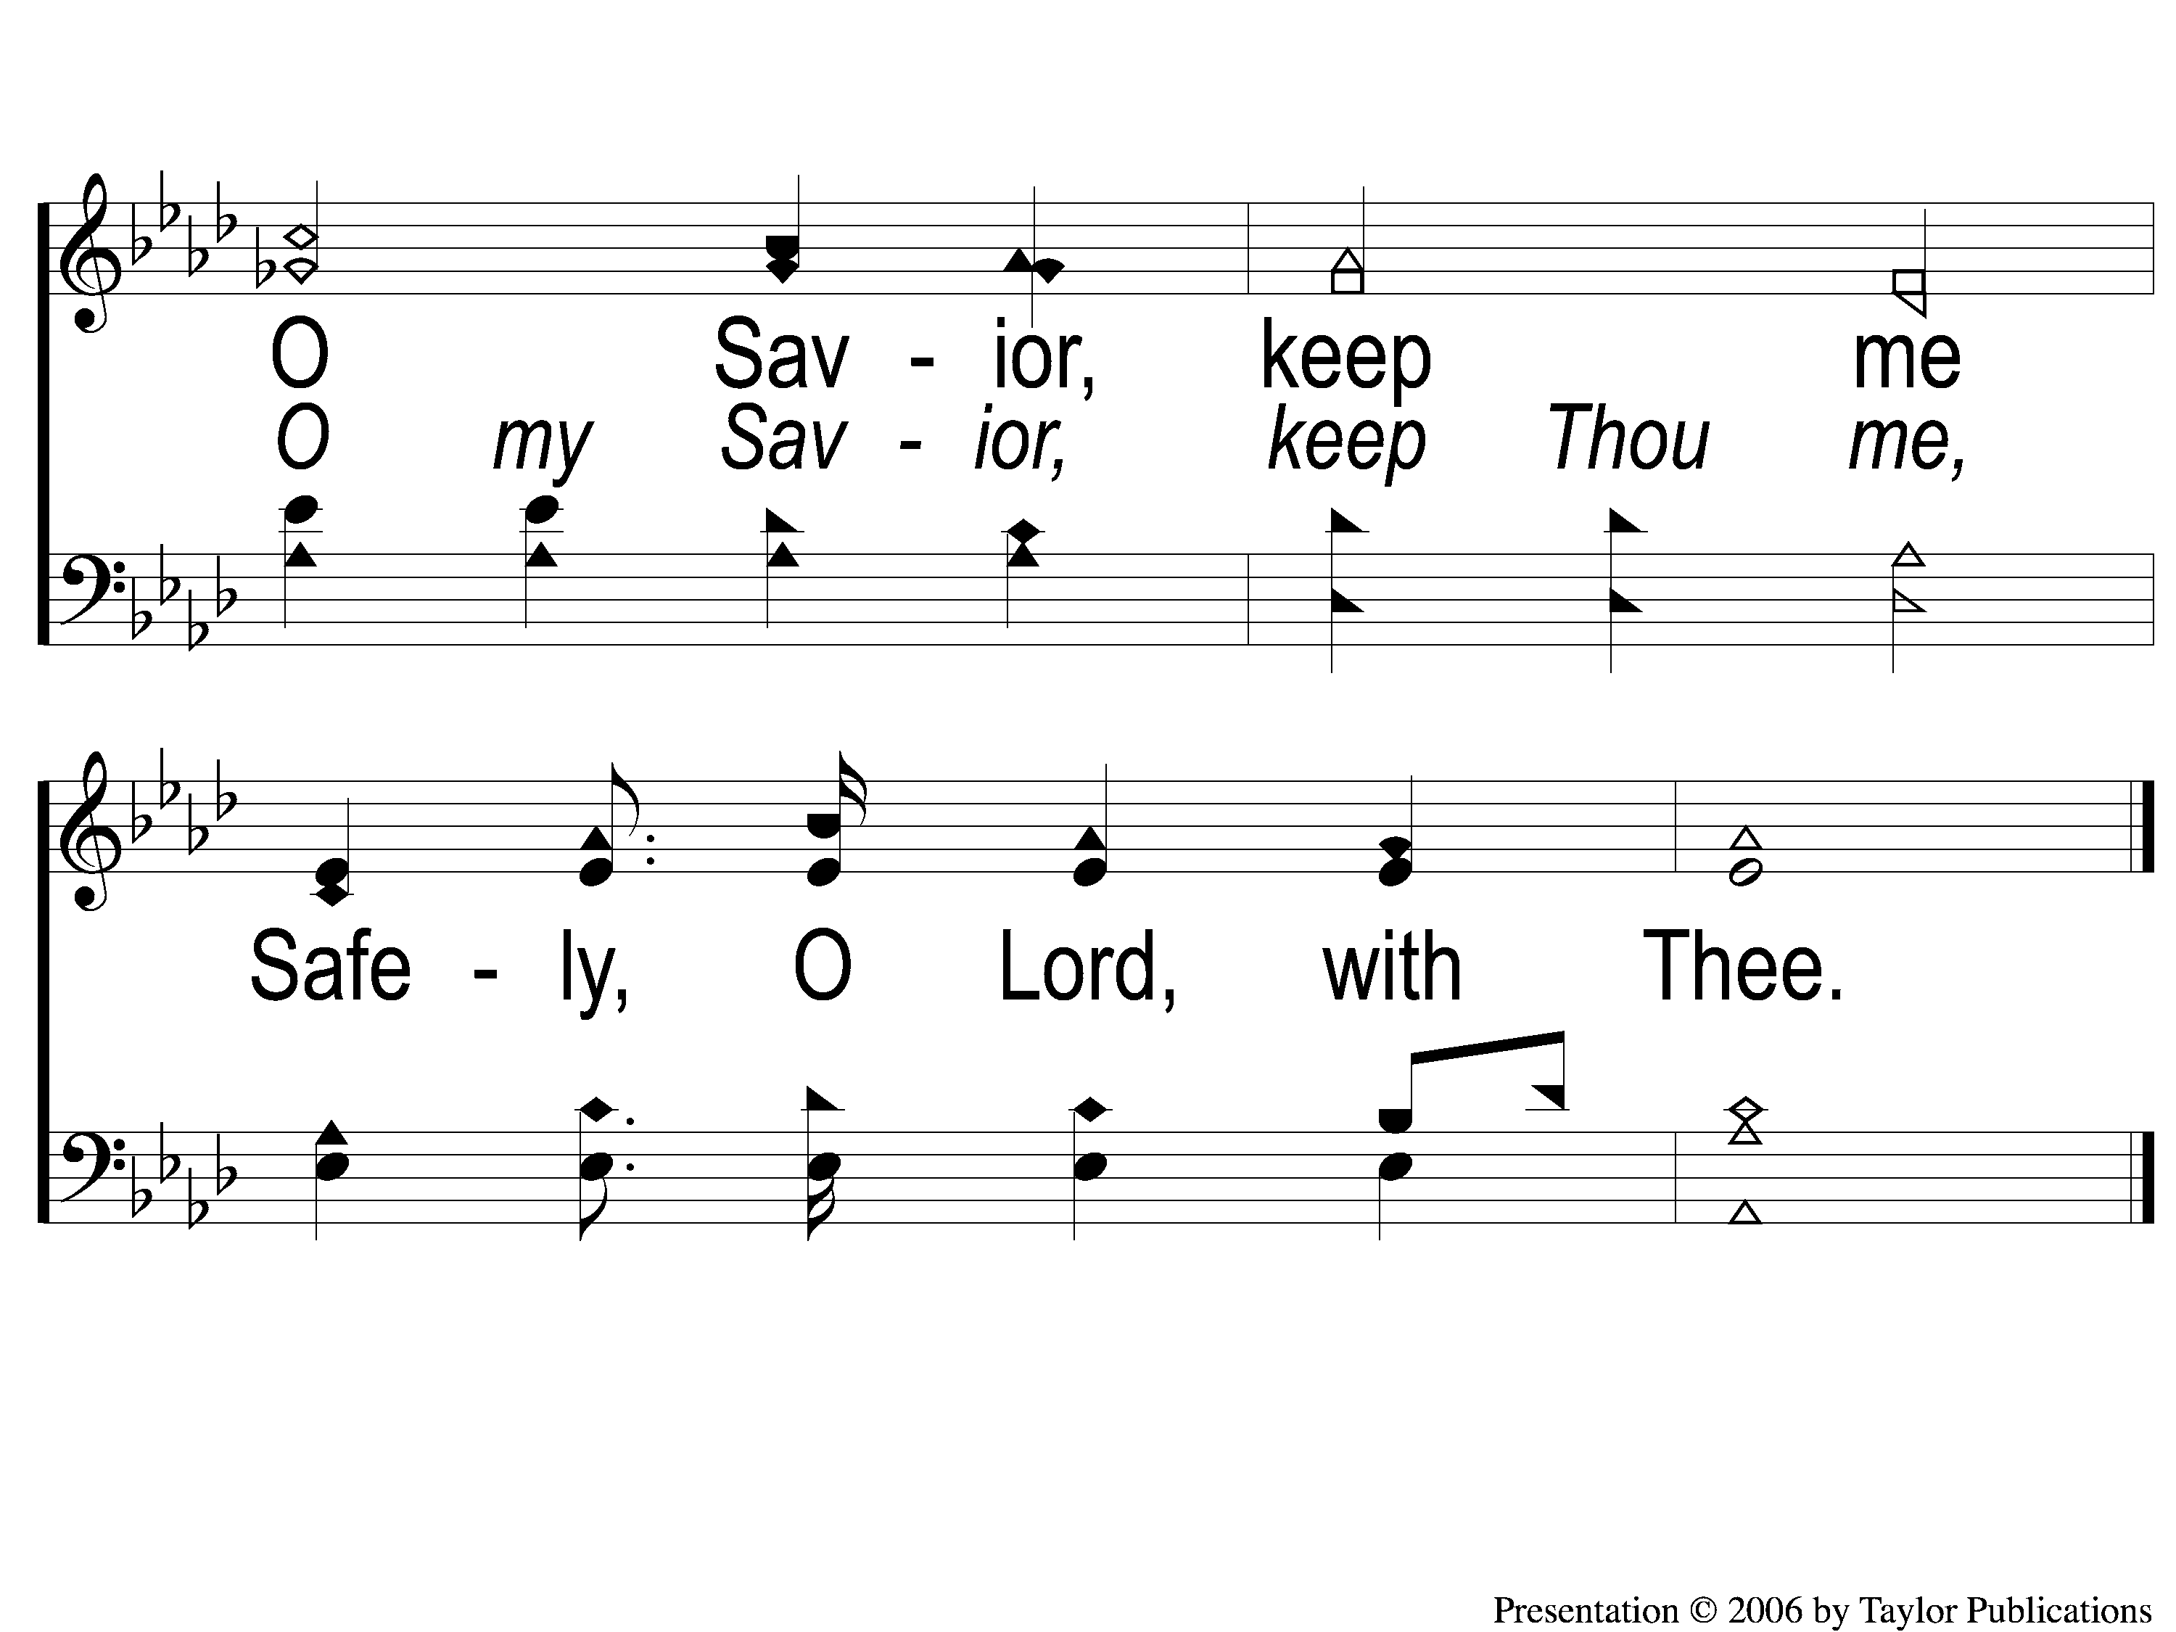
C-2 Hide Me, O My Savior
Hide Me, O My Savior
177

Slide 5
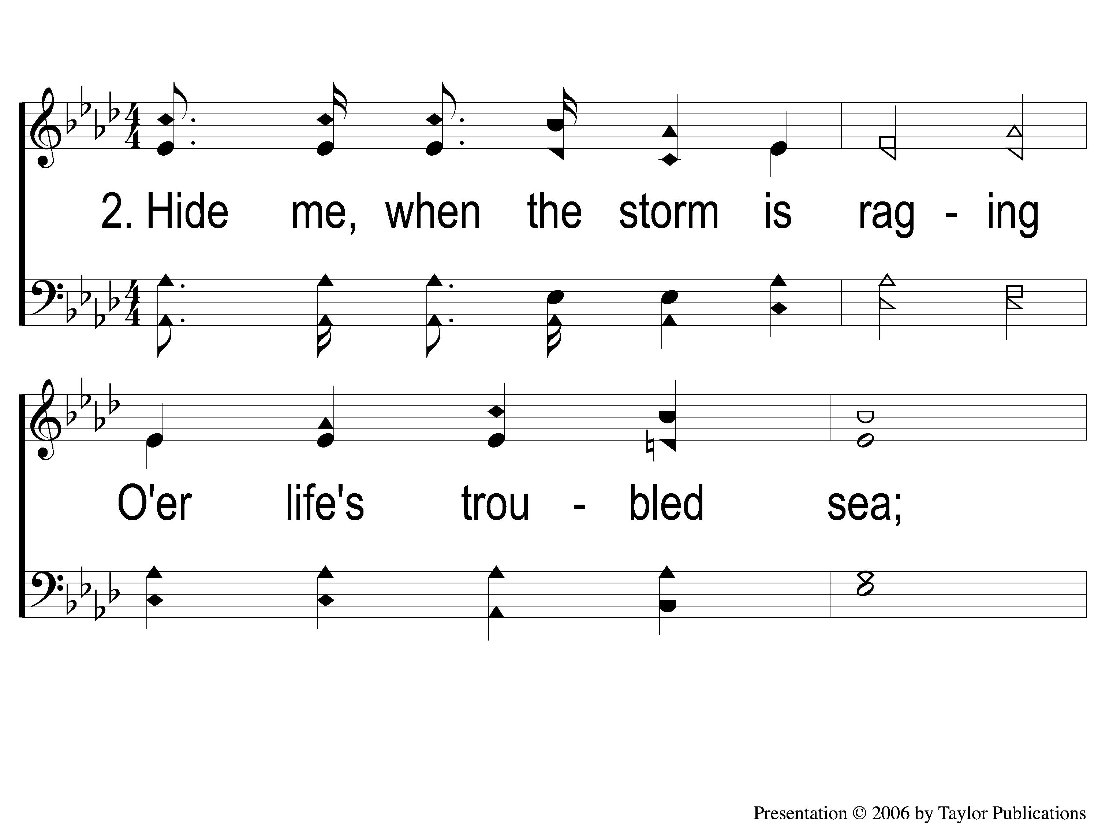
2-1 Hide Me, O My Savior
Hide Me, O My Savior
177

Slide 6
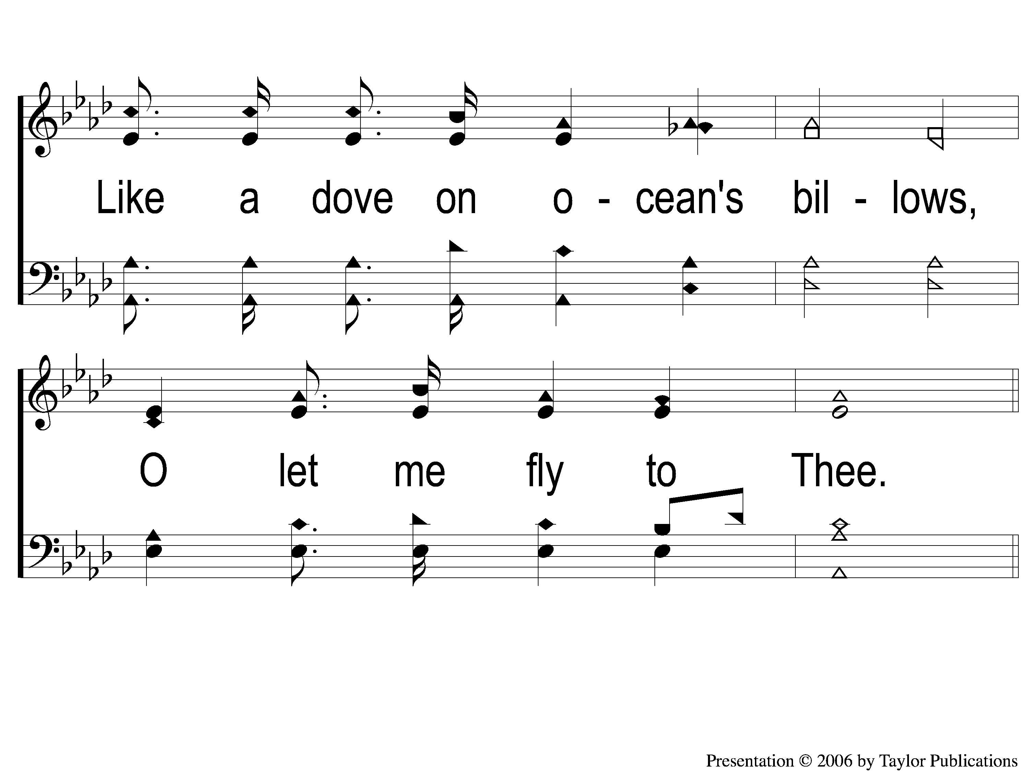
2-2 Hide Me, O My Savior
Hide Me, O My Savior
177

Slide 7
C-1 Hide Me, O My Savior
Hide Me, O My Savior
177

Slide 8
C-2 Hide Me, O My Savior
Hide Me, O My Savior
177

Slide 9
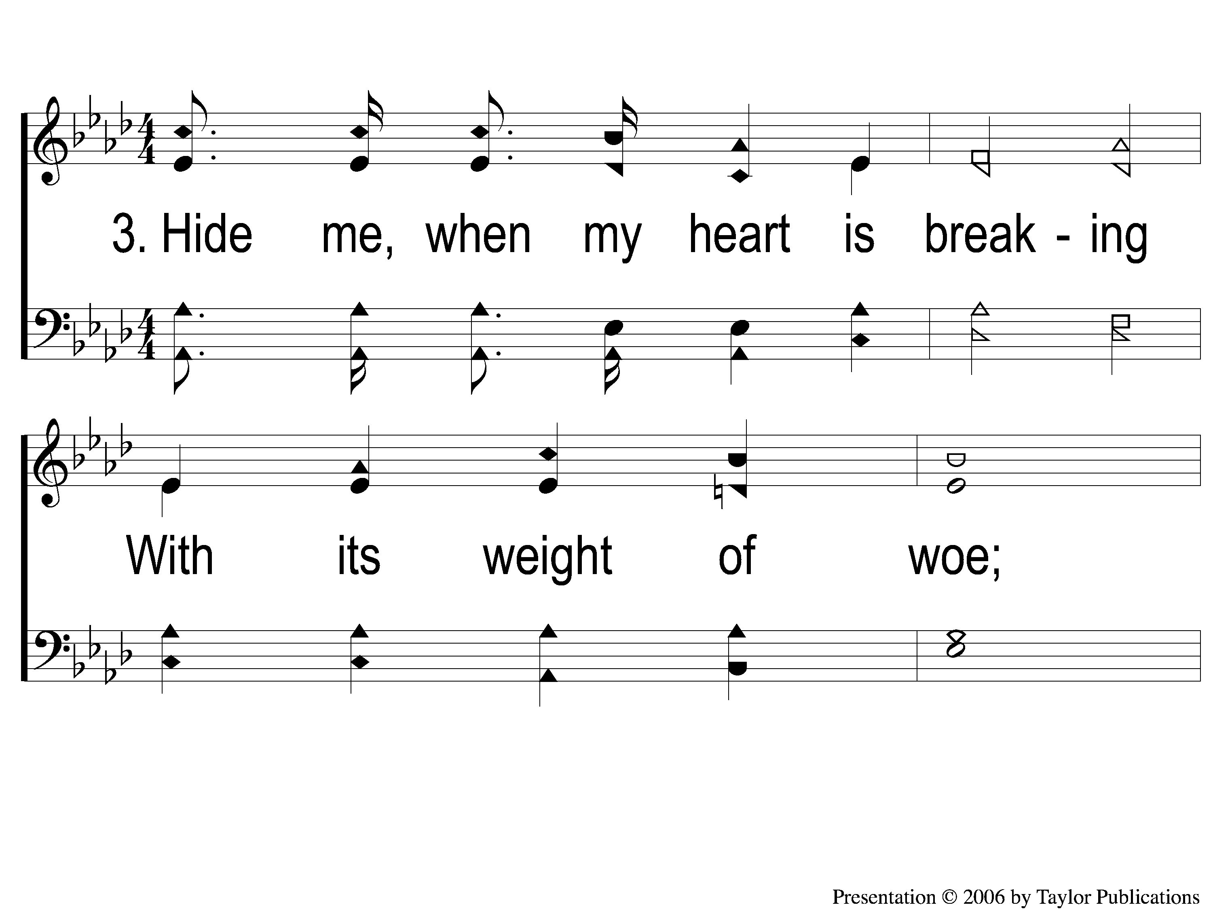
3-1 Hide Me, O My Savior
Hide Me, O My Savior
177

Slide 10
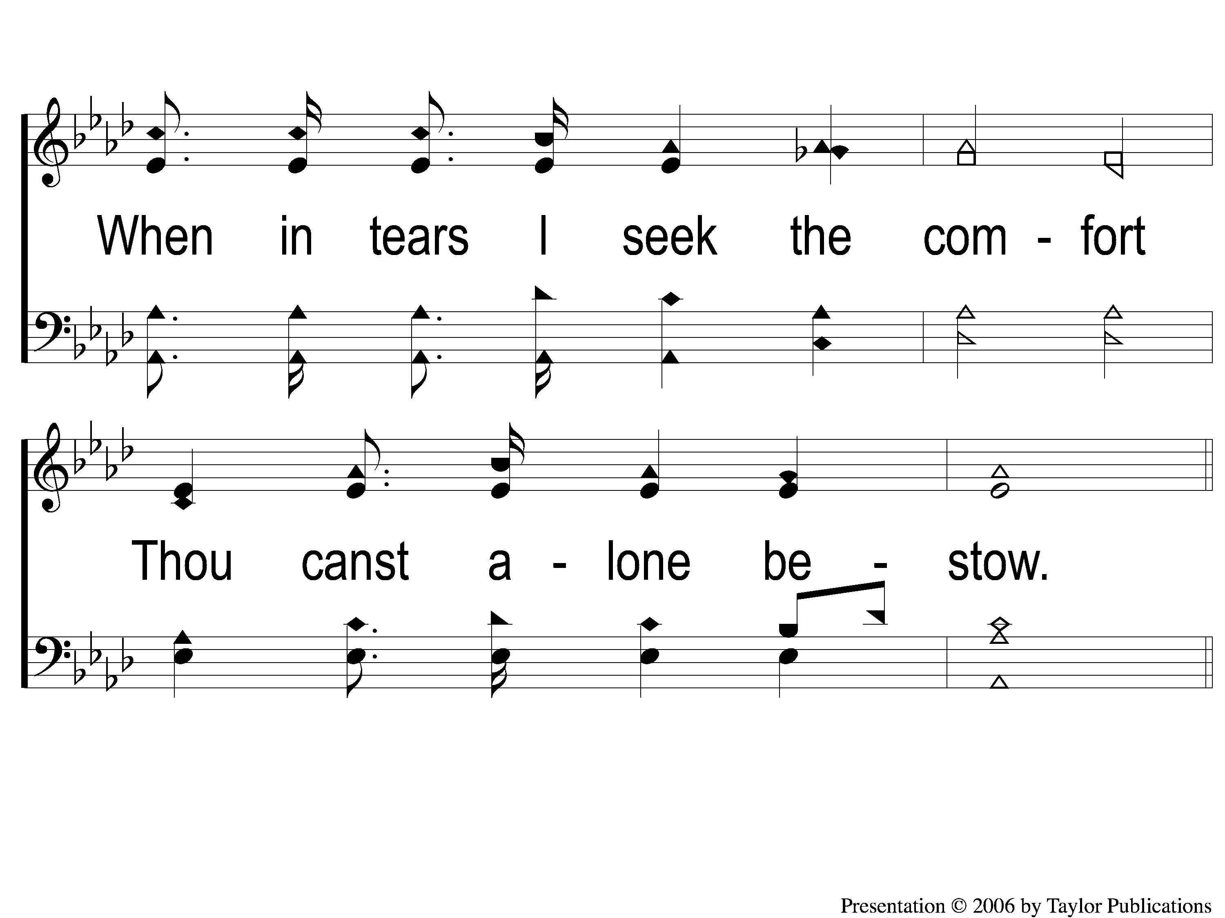
3-2 Hide Me, O My Savior
Hide Me, O My Savior
177

Slide 11
C-1 Hide Me, O My Savior
Hide Me, O My Savior
177

Slide 12
C-2 Hide Me, O My Savior
Hide Me, O My Savior
177

